Slide 1


SMART POLICE
MAIN PROJECT

Slide 2
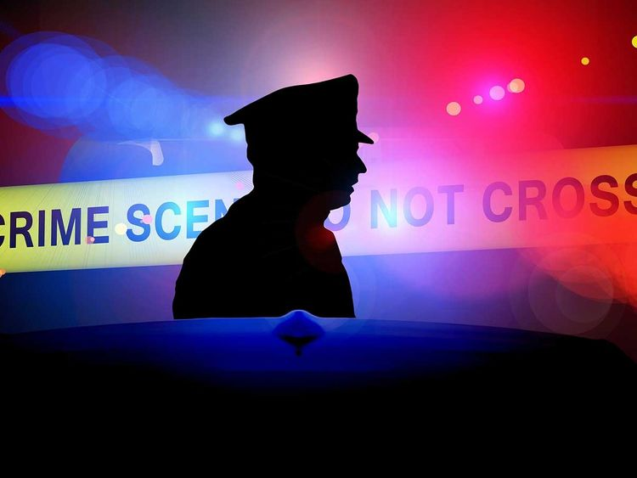
TEAM MEMBERS
BASIM C.I |K.ADARSH| SUJESH K.N

Slide 3

Source of Data
Live Camera Feed
TensorFlow Libraries
YOLO Libraries -Dark flow

Slide 4
Methodology
Techniques and Libraries Used
Deep Learning
Classification
TensorFlow
OpenCV
Yolo DarkFlow

Slide 5
Methodology
Features of Smart Police AI System
Faster Classification .
Advanced Detection.
Smart Alert System.
Live Feed with Auto Capture.

Slide 6
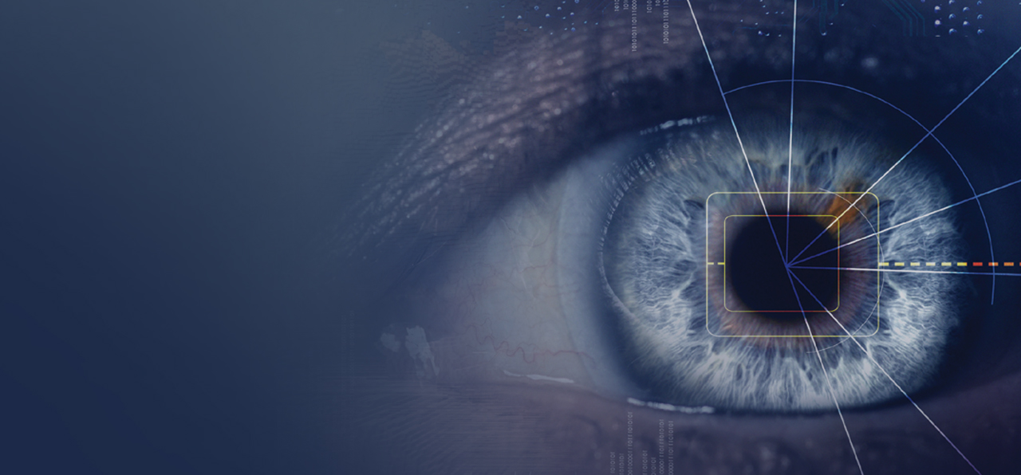
Features of Smart Police AI System
Fully Controlled by Voice.
Faster Classification .
Advanced Detection.
Smart Alert System.
Live Feed with Auto Capture.
Sleepy Driver Detection

Slide 7
Sleepy Driver Detection
Captures frame by frame
If eyes are closed in more than 48 frames an alert is send.

Slide 8
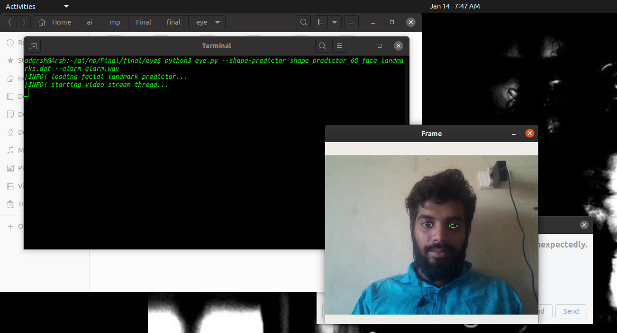

Slide 9

Features of Smart Police AI System
Fully Controlled by Voice.
Faster Classification .
Advanced Detection.
Smart Alert System.
Live Feed with Auto Capture.
Helmet Detection

Slide 10
Helmet Detection
Captures frame by frame.
When helmet is not detected, image of the frame is captured.
Captured Image is send to Face identification program.

Slide 11
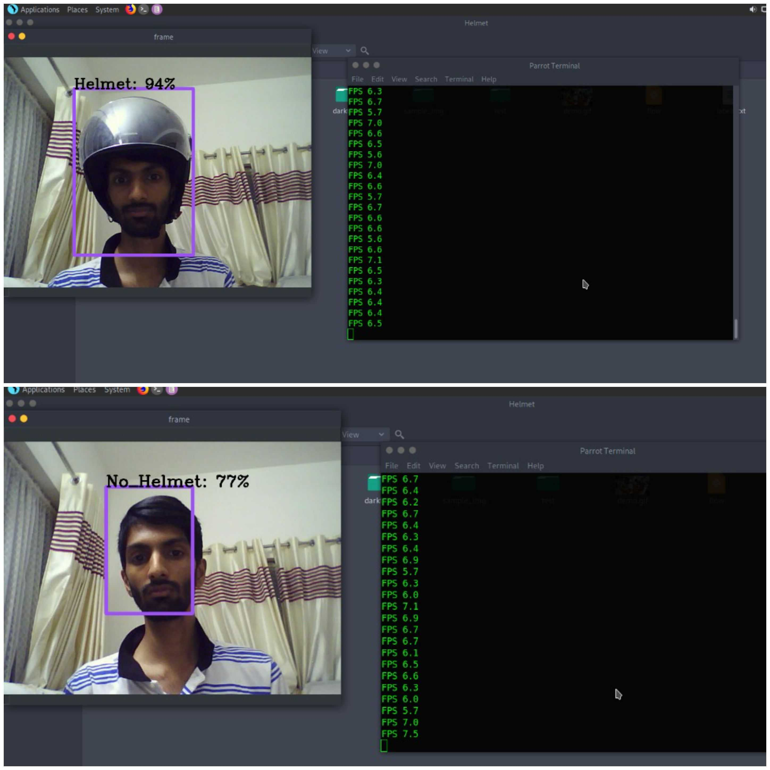

Slide 12
Features of Smart Police AI System
Fully Controlled by Voice.
Faster Classification .
Advanced Detection.
Smart Alert System.
Live Feed with Auto Capture.
Face Identification

Slide 13
Face Identification
Captures frame by frame,or loads images from file.
Search for Image in Database and person is identified based on facial match.

Slide 14
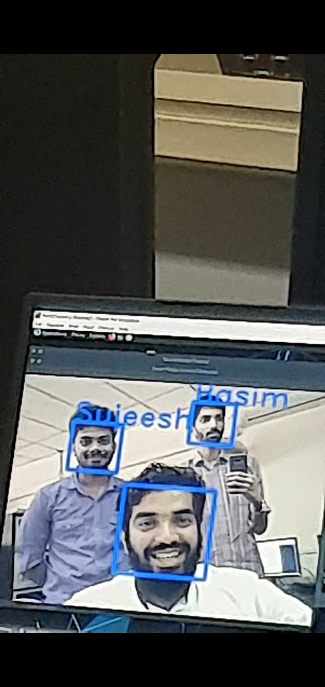

Slide 15
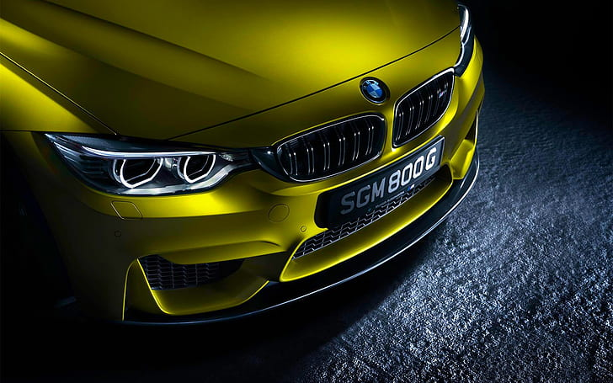
Features of Smart Police AI System
Fully Controlled by Voice.
Faster Classification .
Advanced Detection.
Smart Alert System.
Live Feed with Auto Capture.
Car Identification

Slide 16
Car Identification
Capture frame by frame.
When car is detected an image is taken.
The output Image is send to number Plate Identification Program

Slide 17
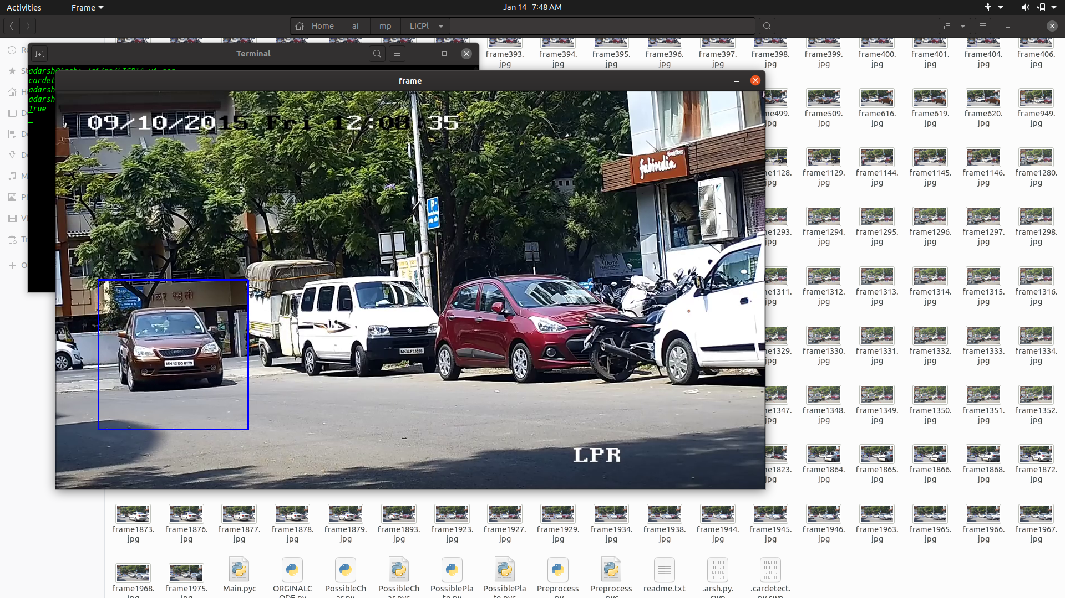

Slide 18
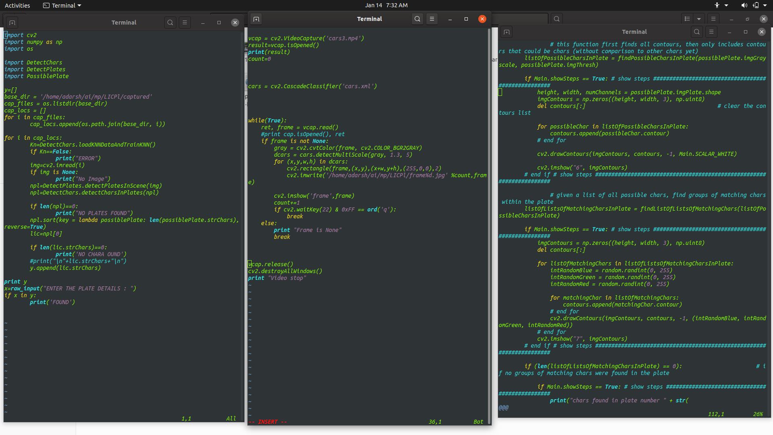

Slide 19
Features of Smart Police AI System
Fully Controlled by Voice.
Faster Classification .
Advanced Detection.
Smart Alert System.
Live Feed with Auto Capture.
Car Number Plate Identification

Slide 20
Car Number Plate Detection
Reads the Image.
Crops the image so output will be only number plate.
Converts it into Greyscale Image.
Characters are recognized using OCR Technique.
Data are stored in Database.

Slide 21
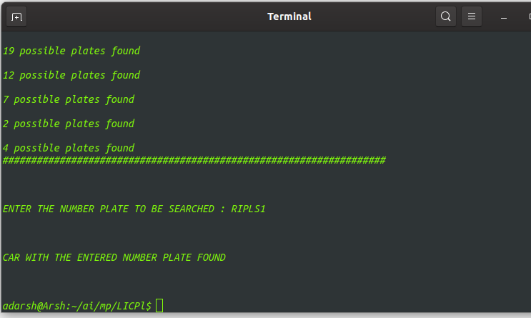

Slide 22


Slide 23

Thank You

